Slide 1
REACTJS & REACT-REDUX
Shalini Mittal
Corporate Trainer

Slide 2
Contents
Immutability in javascript
Pure Function
State management in react
Redux Principles
Redux Terminologies
Redux simple application
Redux – React application
Action creators
Middleware
Context API
Notes:
https://mindmajix.com/react-js-vs-angular-js
https://www.telerik.com/kendo-react-ui/components/

Slide 3
Change state immutably - Arrays
Always remember to change state immutably. Lets understand it with few examples:
const arr = ['a', 'b']
// Create a new copy of arr, with "c" appended to the end
const arr2 = arr.concat("c");
// or, we can make a copy of the original array:
const arr3 = arr.slice();
// and mutate the copy:
arr3.push("d");
console.log(arr)
const nos = [3, 1, 7, 9, 3, 4, 6, 2]
//create a copy and then sort
console.log([...nos].sort())
console.log(nos)

Slide 4
Change state immutably - Objects
function reducer(state, action) {
return {
...state, // copy the state (level 0)
house: {
...state.house,
name:'shalini'
},
};
}
let state = {
house: {
name: "Ravenclaw",
points: 17,
},
};
function reducer(state, action) {
return {
...state,
// copy the state (level 0)
name:'shalini'
};
}
let state4 = {
name: "Ravenclaw",
points: 17,
};

Slide 5
Change state immutably – Deep Nested Objects
function reducer3(state, action) {
// Add 3 points to Ravenclaw,
// when the name is stored in a variable
const key = "ravenclaw";
return {
...state, // copy state
houses: {
...state.houses, // copy houses
[key]: { // update one specific house (using Computed Property syntax)
...state.houses[key], // copy that specific house's properties
points: state.houses[key].points + 3 // update its `points` property
}
}
}
}
const state2 = {
houses: {
gryffindor: {
points: 15
},
ravenclaw: {
points: 18
},
hufflepuff: {
points: 7
},
slytherin: {
points: 5
}
}
}

Slide 6
Pure Function
A pure function is a function which:
Given the same input, will always return the same output.
Produces no side effects.
Pure functions take some input and return some output based on that input.
They are the simplest reusable building blocks of code in a program.
Perhaps the most important design principle in computer science is KISS (Keep It Simple, Stupid).

Slide 7
Pure Function Features
Pure functions have many beneficial properties, and form the foundation of functional programming.
Pure functions are completely independent of outside state, and as such, they are immune to entire classes of bugs that have to do with shared mutable state.
Their independent nature also makes them great candidates for parallel processing across many CPUs, and across entire distributed computing clusters, which makes them essential for many types of scientific and resource-intensive computing tasks.
easy to move around, refactor, and reorganize in your code, making your programs more flexible and adaptable to future changes.
A pure function must not rely on any external mutable state, because it would no longer be deterministic or referentially transparent.

Slide 8
Examples
Math.random(); // => 0.4011148700956255 Math.random(); // => 0.8533405303023756 Math.random(); // => 0.3550692005082965Even though we didn’t pass any arguments into any of the function calls, they all produced different output, meaning that `Math.random()` is not pure.
For example, the following function is pure:
const highpass = (cutoff, value) => value >= cutoff;
The same input values will always map to the same output value:
highpass(5, 5); // => true highpass(5, 5); // => true highpass(5, 5); // => true

Slide 9
State management in React
In SPA, data management at client side is far more complicated than just imagine.
ReactJS relies on the State of the application.
However, In React.js state management is possible, but when the application gets bigger and bigger, unwanted errors and data changes are detected, and which module has changed which state and which view is updated, all these matters get complex, and we feel like, we trapped in our application.

Slide 10
How data is passed
Data is passed down the component tree via props
The count, stored in App’s state, would be passed down as a prop:
For data to come back up the tree, it needs to flow through a callback function, so that callback function must first be passed down to any components that want to call it to pass data up.

Slide 11

Nested level
Passing Data Multiple Levels is a Pain.
Sooner or later you run into a situation where a top-level container has some data, and a child 4+ levels down needs that data. Here’s an example from LinkedIN, with all the avatars highlighted
Intermediate components are forced to accept and pass along props that they don’t care about. This means refactoring and reusing those components will be harder than it needs to be. This is prop-drilling
Wouldn’t it be nice if the components that didn’t need the data didn’t have to see it at all?
Notes:
Let’s pretend the top-level App component holds the user object in state. The user contains the current user’s avatar, handle, and other profile info.
In order to deliver the user data to all 3 Avatar components, the user needs to be woven through a bunch of intermediate components that don’t need the data.

Slide 12
Redux
Redux can help by giving you one global “parent” where you can store the data, and then you can connect the sibling components to the data with React-Redux.
A state container for JavaScript applications.
Normally with React, you manage state at a component level, and pass state around via props.
With Redux, the entire state of your application is managed in one immutable object. Every update to the Redux state results in a copy of sections of the state, plus the new change.
Redux was originally created by Dan Abramov and Andrew Clark.

Slide 13
Why use Redux
Easily manage global state - access or update any part of the state from any Redux-connected component
Easily keep track of changes with Redux DevTools - any action or state change is tracked and easy to follow with Redux. The fact that the entire state of the application is tracked with each change means you can easily do time-travel debugging to move back and forth between changes.
The downside to Redux is that there's a lot of initial boilerplate to set up and maintain (especially if you use plain Redux without Redux Toolkit).
A smaller application may not need Redux and may instead benefit from simply using the Context API for global state needs.

Slide 14
Three Principles of Redux
Single source of truth.
The state is read-only.
Changes are made with pure functions.
It is the state of our whole application is stored in an object within a single store.
There is an only way to change the state is to emit an action, an object describing what happened.
To specify how actions transform the state, you write pure reducers.

Slide 15
Redux Terminology
Actions
Reducers
Store
Dispatch
Connect
Notes:
https://bumbu.me/simple-redux/

Slide 16
Actions
An action sends data from your application to the Redux store.
An action is conventionally an object with two properties: type and (optional) payload.
The type is generally an uppercase string (assigned to a constant) that describes the action.
The payload is additional data that may be passed
Action Type: const DELETE_TODO = 'DELETE_TODO’
Action: { type: DELETE_TODO, payload: id, }
An action creator is a function that returns an action. const deleteTodo = (id) => ({ type: DELETE_TODO, payload: id })

Slide 17
Reducers
A reducer is a function that takes two parameters: state and action.
A reducer is immutable and always returns a copy of the entire state.
A reducer typically consists of a switch statement that goes through all the possible action types.
Following are the things you should never do inside a reducer:
Mutate reducer’s arguments;
Perform side effects like database calls, API calls, and routing transitions;
Call non-pure functions, e.g., Date.now() or Math.random()
const initialState = {
todos: [
{ id: 1, text: 'Eat'},
{ id: 2, text: 'Sleep'},
],
loading: false,
hasErrors: false,
}
function todoReducer(state = initialState, action)
{
switch (action.type) {
case DELETE_TODO:
return {
...state,
todos:
state.todos.filter((todo) =>
todo.id !== action.payload),
}
default: return state
}
}

Slide 18
Store
The Redux application state lives in the store, which is initialized with a reducer.
When used with React, a <Provider> exists to wrap the application, and anything within the Provider can have access to Redux.
A store has the following responsibilities:
Holds application state;
Allows access to state via getState();
Allows state to be updated via dispatch(action);
Registers listeners via subscribe(listener);
It handles unregistering of listeners via the function returned by subscribe(listener)
import { createStore } from 'redux’
import { Provider } from 'react-redux’
import reducer from './reducers’
const store = createStore(reducer)
render(
<Provider store={store}>
<App />
</Provider>,
document.getElementById('root') )

Slide 19
Dispatch
dispatch is a method available on the store object that accepts an object which is used to update the Redux state.
Usually, this object is the result of invoking an action creator
const Component = ({ dispatch }) => {
useEffect(() => {
dispatch(deleteTodo())
},
[dispatch]
)}

Slide 20
Connect
The connect() function is one typical way to connect React to Redux.
A connected component is sometimes referred to as a container
connect is pure
connect automatically makes connected components “pure,” meaning they will only re-render when their props change – a.k.a. when their slice of the Redux state changes.
This prevents needless re-renders and keeps your app running fast.

Slide 21
Simple Redux application without React
Create a folder with package.json file using npm init --y
Install redux package => npm I redux –save
Then create a simple node js file. Import the createStore from redux module
Define initial state
import redux from 'redux’; const {createStore} = redux; const initialState = { value: 0 }
Create a reducer =>
counterReducer(state = initialState, action) {
// Check to see if the reducer cares about this action
if (action.type === 'INCR') {
// If so, make a copy of `state`
return {
...state,
// and update the copy with the new value
value: state.value + 1
}
}
if (action.type === 'DECR') {
// If so, make a copy of `state`
return {
...state,
// and update the copy with the new value
value: state.value - 1
}
}
// otherwise return the existing state unchanged
return state
}
Create a store passing in the reducer function. const store = createStore(counterReducer)
getState() gets the state of the store store.getState()
To communicate with the store, dispatch action as follows: store.dispatch({type:'INCR’})
To subscribe for state changes : store.subscribe(()=>{console.log(store.getState())})

Slide 22
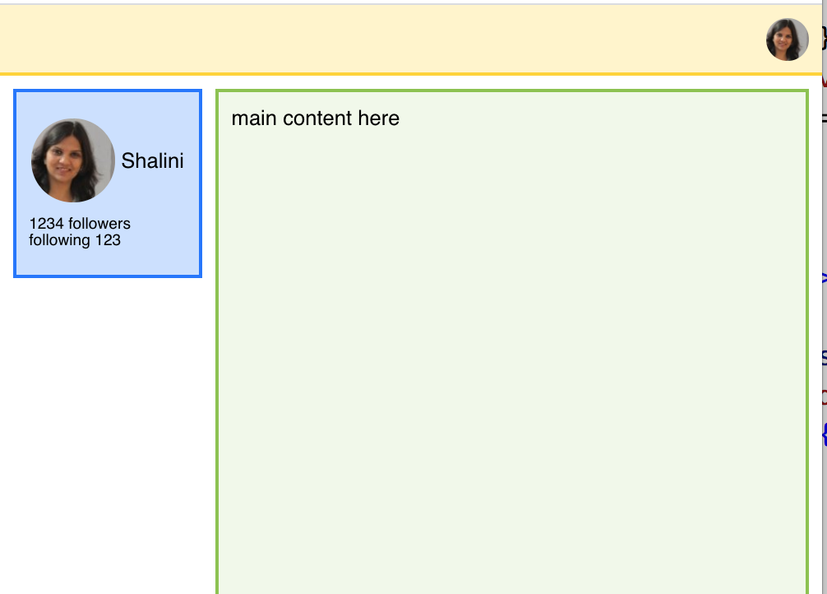
What we will create
App
NavBar
Body
UserAvatar
UserAvatar
UserStats
Content
SideBar

Slide 23
Understand state managament
Create previous application using props for state management
Then modify to use children as state management
Then modify to implement redux for state management.
Lastly understand how to add Context API for state management.
All the above use cases, use almost the same code with a difference of how the data is passed in the application

Slide 24
Implement Redux in React
Need redux and react-redux libraries
Create a store to be made available to the whole application as follows: const store =createStore(reducer)
Create a reducer function and pass this function to the store
The react-redux module comes in with the Provider component. The App component is wrapped around the Provider component that takes store as a prop whose value is set to the store created before.
This Provider provides a way to inject the store to our application. import {Provider} from ‘react-redux’ <Provider store={store}><App /></Provider>

Slide 25
Connect Redux store to React
There needs to be a way to connect or subscribe with the store created.
In React we do not manually subscribe to the store but instead use connect from react-redux. It is a function that returns a higher order component .
It returns a function that takes a component as an input. connect(mapStateToProps, mapDispatchToProps)(Counter);
Since to access or update data in the store, we need to get the store object or subscribe to it. In react we do not directly subscribe instead we need 2 configurations as follows:
This function is responsible to map the store state to the props in the component as props are immutable
Next is the action to be dispatched to the store to update the state
const mapStateToProps = (state)=>{ return{ctr: state.counter} }
// please give me the values of counter property stored in store in a propery ctr to be used in Counter component
const mapDispatchToProps =(dispatch)=>{
return {
onIncrementCounter: () => dispatch({type:'INCREMENT'}),
onDecrementCounter: () => dispatch({type:'DECREMENT'}),
onAddCounter: () => dispatch({type:'ADD', payload: 5}),
onSubtractCounter: () => dispatch({type:'SUBTRACT', payload:5}),
}
}

Slide 26
Creating actions as constant
Since actions to be dispatched will be used across the application, it is better to keep all the actions in a separate file and use them.
Create a file actions.js and store the below constants in a file.
Replace the constants used everywhere with the variables defined below
export const INCREMENT = "INCREMENT"
export const DECREMENT = "DECREMENT"
export const STORE_RESULT = "STORE_RESULT"
export const ADD = "ADD"
export const SUBTRACT = "SUBTRACT"
export const DELETE_RESULT = "DELETE_RESULT"

Slide 27
Combine Reducers
Many a times having a single reducer may become complex over time.
In our counter application, we have results and value which can be split into reducer.
So split the reducers in files, counter.js and results.js.
Then we need a way to combine these both reducers. React provides with combineReducer function that takes an object as a parameter mapping our reducers to different slices of our state and merging the different reducers
Now to access any of the counter property defined in the count.js, from within the Counter.js, use the following syntax
const rootReducer = combineReducers({
ctrReducer:countReducer,
resReducer:resultReducer
})
const store = createStore(rootReducer)
const mapStateToProps = (state)=>{ return{
ctr: state.ctrReducer.counter,
storeResults : state.resReducer.results
}
}

Slide 28
Access state of other reducer
Now with all the changes, Counter.js is able to access the counter state from count.js file, but result reducer is unable to access the counter state to store the counter value in results array.
Reducers don’t have access to the global state. So the way reducers have access to data is by passing in the payload to the reducers.
So in Counter.js file, update the onStoreResult for passing the ctr value as follows: onStoreResult :(result) => dispatch({type:actionTypes.STORE_RESULT,result:result})
Also update the button click to pass the counter value as follows: <button onClick={()=>this.props.onStoreResult(this.props.ctr)}>Store Result</button>

Slide 29
Types of state
TYPE | EXAMPLE | USE REDUX
LOCAL UI STATE | Show / Hide backdrop, Modal boxes | Manageable by the components
PERSISTENT STATE | All users, all posts | Stores on server, relevant slice managed by redux
CLIENT STATE | IsAuthenticated, filters set by user | Managed via redux

Slide 30
Redux Features
Easy Debugging with Redux: With the Redux DevTools extension you get an automatic log of every action your app performed. At any time you can pop it open and see which actions fired, what their payload was, and the state before and after the action occurred.
Another great feature the Redux DevTools enable is time travel debugging a.k.a. you can click on any past action and jump to that point in time, basically replaying every action up to and including that one (but no further). The reason this can work is because each action immutably update’s the state, so you can take a list of recorded state updates and replay them, with no ill effects, and end up where you expect.
Then there are tools like LogRocket that basically give you an always-on Redux DevTools in production for every one of your users. Got a bug report? Sweet. Look up that user’s session in LogRocket and you can see a replay of what they did, and exactly which actions fired. That all works by tapping into Redux’s stream of actions.

Slide 31
Redux DevTools
Install the redux devtools extension and react extension for chrome.
For the devtools work follow the steps from the below link: https://github.com/zalmoxisus/redux-devtools-extension
Go to advanced 1.2, and copy the constant window.__REDUX_DEVTOOLS_EXTENSION_COMPOSE__
Create a constant composeEnhancer in index.js file as follows: const composeEnhancers = window.__REDUX_DEVTOOLS_EXTENSION_COMPOSE__ || compose;
Compose is a function from redux library which is a enhancer for the middleware: const store = createStore(rootReducer,composeEnhancers( applyMiddleware(logger)));
Now when the browser is refreshed, the redux devtools will show the current state of the store and all the details

Slide 32
Customize Redux with Middleware
Redux supports the concept of middleware, which is a fancy word for “a function that runs every time an action is dispatched.”
For instance…
Want to kick off an API request every time an action name starts with FETCH_? You could do that with middleware.
Want a centralized place to log events to your analytics software? Middleware is a good place for that.
Want to prevent certain actions from firing at certain times? You can do that with middleware, transparent to the rest of your app.
Want to intercept actions that have a JWT token and save them to localStorage, automatically? Yep, middleware.
Handle some crash reporting

Slide 33
Pattern With and Without Middleware
First, let's look at a redux pattern without middleware: 1. An event occurs 2. An action is dispatched 3. Reducer creates a new state from the change prescribed by the action 4. New state is passed into the React app via props
Adding middleware gives us a place to intercept actions and run side effects before or after an action occurs. After dispatching an action, it will first go through the middleware, then into the reducer.
Our new pattern with middleware now looks like:
1. An event occurs 2. An action is dispatched 3. Middleware receives the action 4. Reducer creates a new state from the change prescribed by the action 5. New state is passed into the React app via props

Slide 34
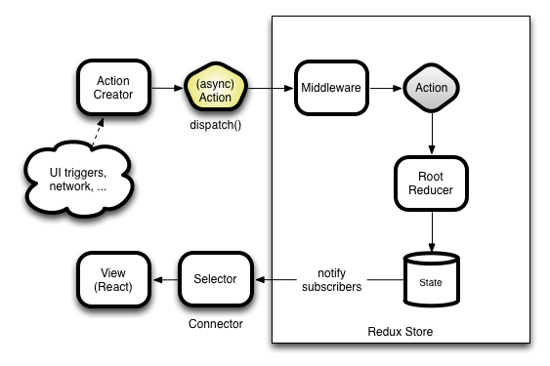

Slide 35
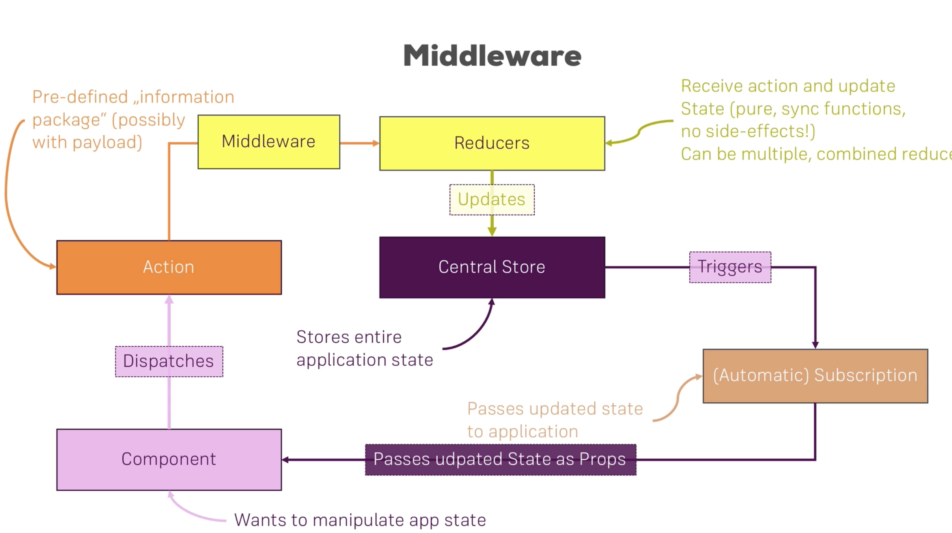
Understand Middleware

Slide 36
What is Middleware
Middleware provides a third-party extension point between dispatching an action and handing the action off to the reducer:
[ Action ] <-> [ Middleware ] <-> [ Dispatcher ]
Middleware allows for side effects to be run without blocking state updates.
We can run side effects (like API requests) in response to a specific action, or in response to every action that is dispatched (like logging). There can be numerous middleware that an action runs through before ending in a reducer.
Middleware syntax: storeInstance => functionToCallWithAnActionThatWillSendItToTheNextMiddleware => actionThatDispatchWasCalledWith => valueToUseAsTheReturnValueOfTheDispatchCall
Typically written as store => next => action => result
Which you then use by using Redux’s applyMiddleware function. const middlewares = applyMiddleware(middleware1, middleware2) const store = createStore(reducers, initialState, middlewares)

Slide 37
What can we do in middleware
Anything that should take place as a result of the action, but doesn't change state.
Here's an example that logs every action:
We have access to the action itself within our middleware, so we can log it:
We also have access to state, so we can log the current state before the action is received:
After next is called with our action, we can log the new state created in response to our action
when we call next with the action, we are passing it down the middleware pipeline. This makes the action continue through to the following middleware, then into the reducer const loggingMiddleware = (store) => (next) => (action) => { // we will catch every action here, regardless of the type // log the current action console.log('dispatching', action) // log current state from the store console.log('previous state', store.getState()) // continue execution of the action next(action) // log the updated state, after calling next(action) console.log('new state', store.getState()) }

Slide 38
Difference between store.dispatch and next
Calling next continues the propagation of the current action. It's important to not alter the action and to call it once and only once within a middleware.
Calling store.dispatch starts the new action from the beginning of the pipeline. This can be called as many times as needed from within middleware.
For example, in response to receiving new data from an API call, or an error.
Use next to continue an action, use store.dispatch to send a new action.

Slide 39
Difference between store.dispatch and next
const apiMiddleware = (store) => (next) => (action) => {
switch(action.type) {
// only catch a specific action
case 'FETCH_MOVIE_DATA’:
// continue propagating the action through redux
// this is our only call to next in this middleware
next(action)
// fetch data from an API that may take a while to respond
MyMovieApi.get('/movies') .then(res => {
// successfully received data, dispatch a new action with our data
store.dispatch({ type: 'SET_MOVIE_DATA', payload: { movies: res.data }, }) })
.catch(err => {
// received an error from the API, dispatch a new action with an error
store.dispatch({ type: 'SET_MOVIE_DATA_ERROR', payload: { error: err }, })
})
break
// if we don't need to handle this action, we still need to pass it along
default:
next(action) } }
export default apiMiddleware

Slide 40
Middleware In Action
To create a middleware function of our own, create in index.js file as follows:
Import applyMiddleware from redux module and provide this middleware to our redux application as follows: const store = createStore(rootReducer, applyMiddleware(logger));
Now if the counter application is restarted, the middleware is in action
const logger =(store)=>{
return (next)=>{
return action=>{
console.log('[Middleware dispatching', action);
console.log('[Middleware access to store',store);
const result = next(action);
console.log('[Middleware] next state', store.getState());
return result;
}
}
}

Slide 41
Running asynchronous code
There may be requirements that we need to update the store after some network calls which may be asynchronous in nature.
The reducers of the redux store cannot make any asynchronous calls and cannot have any timer events as well like setTimeout as these methods are asynchronous in nature.
The reducers do not even accept a Promise object to be returned.
The way to handle asynchronous calls is through the action creators.

Slide 42
Action Creators
Action creators are a way to create functions that return the action object consisting of the action type and the payload if required.
Create action creator as follows in actions.js file and update the dispatch methods in Counter.js file to access the action creators.
With payload
export const add = (payload)=>{
return{type:ADD,
payload:payload}
};
Without payload
export const increment = ()=>{
return{type:INCREMENT}
};
The dispatch to use the action creators
onIncrementCounter: () => dispatch(actionCreators.increment()),

Slide 43
Redux Thunk
This library is a middleware that allows the action creators do not return the action itself but return a function itself that will dispatch the action.
Detailed instructions: https://github.com/reduxjs/redux-thunk
A thunk is a function that returns another function. For example:
function say() { return function something() { //code here }; }
The above function say() is a thunk because it returns another function in this case something(). How is this useful?
In redux reducers are pure functions hence we can't do any async operations inside the reducers and actions are just plain old objects.
Dispatch method inside the store accepts an action object as its parameter, what the redux thunk middleware does is that, if say an action creator returns a function instead of an object then it simply executes that returning function.
Notes:
If you’re curious, a thunk is a concept in programming where a function is used to delay the evaluation/calculation of an operation.

Slide 44
Redux Thunk
Returning function can accept two parameters those are dispatch and getState.
This is great because with dispatch we can call other action creators.
So now all we do for async operations is to do everything that will be async inside the returning function and then call the relevant action creators when the data comes back passing in the new data that we get from the API.
The other relevant action creators in this case receive_post will then pass this new data in an action object to the reducer and then the reducer can update the application's state with the new data.
Notes:
If you’re curious, a thunk is a concept in programming where a function is used to delay the evaluation/calculation of an operation.

Slide 45
Redux Thunk Steps
Install the library using npm i –save redux-thunk
Import the default function as thunk and add it to the store as a middleware: import thunk from 'redux-thunk'; const store = createStore(rootReducer,composeEnhancers( applyMiddleware(logger, thunk)));
Then modify the storeResult in actions.js to implement the redux-thunk middleware functionality as follows:
The thunk has access to the action and can dispatch it after the asynchronous call is executed
export const saveResult =(res)=>{
return {
type:STORE_RESULT,
result:res
}
}
export const storeResult = (payload)=>{
return (dispatch) => {
setTimeout(() => {
dispatch(saveResult(payload))
}, 2000);
}
};
Notes:
If you’re curious, a thunk is a concept in programming where a function is used to delay the evaluation/calculation of an operation.

Slide 46
Redux Thunk Get State
Redux Thunk offers you a way to read the current state of the Redux store.
In addition to dispatch, it also passes getState as the second argument to the function you return from your thunk action creator.
This lets the thunk read the current state of the store
Don’t abuse this pattern. It is good for bailing out of API calls when there is cached data available, but it is not a very good foundation to build your business logic upon. If you use getState() only to conditionally dispatch different actions, consider putting the business logic into the reducers instead.
export const storeResult = (payload)=>{
//thunk gives an additional parameter that can be used to access the previous state of the store
return (dispatch, getState) => {
setTimeout(() => {
const oldCounter = getState().ctrReducer.counter;
console.log(oldCounter)
dispatch(saveResult(payload))
}, 2000);
}
};

Slide 47
Context API
Don’t need all those fancy features of Redux.
Don’t care about the easy debugging, the customization, or the automatic performance improvements – all you want to do is pass data around easily.
Maybe your app is small, or you just need to get something working and address the fancy stuff later
Prop drilling : is the processing of getting data from component A to component Z by passing it through multiple layers of intermediary React components. Component will receive props indirectly and you, the React Developer will have to ensure everything works out right. Context solves this problem
Provides a way to pass data through the component tree without having to pass props down manually at every level.
In a typical React application, data is passed top-down (parent to child) via props, but this can be cumbersome for certain types of props (e.g. locale preference, UI theme) that are required by many components within an application. Context provides a way to share values like these between components without having to explicitly pass a prop through every level of the tree.

Slide 48
For Comparison

Slide 49
When to use Context API
authenticated user,
theme, or
preferred language.
Data Cache
Current Locale
https://reactjs.org/docs/context.html
Notes:
https://reacttraining.com/react-router/web/example/auth-workflow
https://dev.to/devdammak/react-hook-usestate-with-react-context-api-3pco
https://www.freecodecamp.org/news/state-management-with-react-hooks/

Slide 50
Steps to create Context
Create the context -> Kind of store
Provide the context value -> Provider
Consume the context value =>
There are 3 important pieces to the context API:
The React.createContext function which creates the context
The Provider (returned by createContext) which establishes the “electrical bus” running through a component tree The Provider is very similar to React-Redux’s Provider. It accepts a value prop. It’ll most likely be an object containing your data and any actions you want to be able to perform on the data
The Consumer (also returned by createContext) which taps into the “electrical bus” to extract the data The Consumer works a little bit like React-Redux’s connect function, tapping into the data and making it available to the component that uses it

Slide 51
Create Context
const MyContext = React.createContext(defaultValue);
Creates a Context object.
When React renders a component that subscribes to this Context object it will read the current context value from the closest matching Provider above it in the tree.
The defaultValue argument is only used when a component does not have a matching Provider above it in the tree.
This can be helpful for testing components in isolation without wrapping them. Note: passing undefined as a Provider value does not cause consuming components to use defaultValue.
Notes:
According to the React documentation, every context object comes with a Provider React component that allows consuming components to subscribe to context changes. It is the provider that allows the context to be consumed by other components

Slide 52
Provide the value
Provide the context value. <MyContext.Provider value={/* some value */}>
Every Context object comes with a Provider React component that allows consuming components to subscribe to context changes.
Accepts a value prop to be passed to consuming components that are descendants of this Provider. One Provider can be connected to many consumers. Providers can be nested to override values deeper within the tree.
All consumers that are descendants of a Provider will re-render whenever the Provider’s value prop changes.
Notes:
The propagation from Provider to its descendant consumers (including .contextType and useContext) is not subject to the shouldComponentUpdate method, so the consumer is updated even when an ancestor component skips an update.

Slide 53
Consume the value - contextType
Consume the context value using contextType available at class level
The contextType property on a class can be assigned a Context object created by React.createContext().
This lets you consume the nearest current value of that Context type using this.context. You can reference this in any of the lifecycle methods including the render function.
class MyClass extends React.Component {
componentDidMount() {
let value = this.context;
/* perform a side-effect at mount using the value of MyContext */
}
componentDidUpdate() {
let value = this.context; }
componentWillUnmount() {
let value = this.context;}
render() {
let value = this.context;
/* render something based on the value of MyContext */
}
}
MyClass.contextType = MyContext;
Notes:
You can only subscribe to a single context using this API. If you need more than one use <MyContext.Consumer>.

Slide 54
Consume the value – using component
A React component that subscribes to context changes. This lets you subscribe to a context within a function component.
Requires a function as a child. The function receives the current context value and returns a React node. The value argument passed to the function will be equal to the value prop of the closest Provider for this context above in the tree. If there is no Provider for this context above, the value argument will be equal to the defaultValue that was passed to createContext().
<MyContext.Consumer>
{value => /* render something based on the context value */}
</MyContext.Consumer>
OR USING HOOKS
Const {contextvalue. contextfunction} = useContext(MyContext)
Notes:
According to the React documentation, every context object comes with a Provider React component that allows consuming components to subscribe to context changes. It is the provider that allows the context to be consumed by other components

Slide 55
Updating Context from a Nested Component
It is often necessary to update the context from a component that is nested somewhere deeply in the component tree.
In this case you can pass a function down through the context to allow consumers to update the context:
// Make sure the shape of the default value passed to // createContext matches the shape that the consumers expect! export const MyContext = React.createContext({ theme: themes.dark, toggleTheme: () => {},});
Notes:
According to the React documentation, every context object comes with a Provider React component that allows consuming components to subscribe to context changes. It is the provider that allows the context to be consumed by other components

Slide 56
Context Example
export const themes = {
light: {
foreground: '#000000',
background: '#eeeeee',
},
dark: {
foreground: '#ffffff',
background: 'crimson',
},
};
export const ThemeContext = React.createContext(
themes.dark // default value
);
Create a ThemeContext.js file as follows:
Create a ThemedButton.js file as follows:
To get the reference of the context created in a class component use the contextType
export default class ThemedButton extends Component {
render() {
let props = this.props;
let theme = this.context;
return (<div>
<button {...props} style={{backgroundColor:theme.background}}>
</button>
</div>
)}} ThemedButton.contextType = ThemeContext
Notes:
According to the React documentation, every context object comes with a Provider React component that allows consuming components to subscribe to context changes. It is the provider that allows the context to be consumed by other components

Slide 57
Context Example Contd
export default function ToolBar(props) {
return (
<div>
<ThemedButton onClick={props.changeTheme}>
Change Theme
</ThemedButton>
</div>
)
}
Create a ToolBar.js file as follows:
Create a Layout.js file as follows that maintains the state of the context and act as a provider
export default class Layout extends Component {
state={ theme:themes.light } toggleTheme = () => {
this.setState(state => ({
theme: state.theme === themes.light
? themes.dark
: themes.light,
}));
}; render() {
return (
<div>
<h1>Provider</h1>
<ThemeContext.Provider value={this.state.theme}>
<ToolBar changeTheme={this.toggleTheme}></ToolBar>
</ThemeContext.Provider>
</div>
);
}
}
function App() {
return (
<div className="App">
<Layout/>
</div>
);
}
Notes:
According to the React documentation, every context object comes with a Provider React component that allows consuming components to subscribe to context changes. It is the provider that allows the context to be consumed by other components

Slide 58
Context Example – Using Consumer
Alternatively, using Consumer component as well , the data from the context can be consumed.
This allows to provide multiple consumers if required.
Functional components do not have contextType, so Consumer component can be used as well
export default class ThemedButton extends Component {
render() {
let props = this.props;
return (
<div>
<h1>With Consumer compoenent</h1>
<ThemeContext.Consumer>
{
(theme)=>(
<button {...props} style={{backgroundColor:theme.background}}>
</button>
)
}
</ThemeContext.Consumer>
</div>
)}}
export default function ThemedButton(props) {
return (
<div>
<h1>With Consumer compoenent</h1>
<ThemeContext.Consumer>
{
(theme)=>(
<button {...props} style={{backgroundColor:theme.background}}>
</button>
)
}
</ThemeContext.Consumer>
</div>
)
}
Notes:
According to the React documentation, every context object comes with a Provider React component that allows consuming components to subscribe to context changes. It is the provider that allows the context to be consumed by other components

Slide 59
Context Example – Using hooks
useContext hook can be used in functional components to consume the value stored in the context.
It takes context as a parameter and returns the value as specified in the createContext method
export default function ThemedButton(props) {
const theme = useContext(ThemeContext);
return (
<div>
<h1>With Consumer compoenent</h1>
<button {...props} style={{backgroundColor:theme.background}}>
</button>
</div>
)
}
Notes:
According to the React documentation, every context object comes with a Provider React component that allows consuming components to subscribe to context changes. It is the provider that allows the context to be consumed by other components

Slide 60
Context Example – Update Context
export const ThemeContext1 = React.createContext({
theme: themes.light,
toggleTheme: () => {},
});
To be able to update the context, pass a function down through the context to allow consumers to update the context:
In Layout.js, update the state object that takes function to modify the context value
Update the Provider in Layout.js as follows:
ThemeButton.js will look as follows:
ToolBar.js as follows:
No need to pass the event props
state = {
theme: themes.dark,
toggleTheme: this.toggleTheme,
};
<ThemeContext1.Provider value={this.state}>
<ToolBar></ToolBar>
</ThemeContext1.Provider>
export default function ThemedButton(props) {
const {theme, toggleTheme} = useContext(ThemeContext1);
return (
<div>
<h1>With Consumer compoenent</h1>
<button onClick={toggleTheme}
style={{backgroundColor:theme.background}}>
{props.children}
</button>
</div>)}
<ThemedButton>
With Event
</ThemedButton>
Notes:
According to the React documentation, every context object comes with a Provider React component that allows consuming components to subscribe to context changes. It is the provider that allows the context to be consumed by other components

Slide 61
Ways to use Consumer
Not fond of the idea of adding the UserContext.Consumer around every place that needs it? If you’d rather receive the value as a prop, you could write a little wrapper around the Consumer like this:
And then you could rewrite, say, UserAvatar to use this new withUser function:
function withUser(Component) {
return function ConnectedComponent(props) {
return (
<UserContext.Consumer>
{user => <Component {...props} user={user}/>}
</UserContext.Consumer>
);
}
}
const UserAvatar = withUser(({ size, user }) => (
<img className={`user-avatar ${size || ""}`} alt="user avatar"
src={user.avatar} />
));
Notes:
This default value is what the Consumer will receive when it is placed in a tree with no Provider above it. If you don’t pass one, the value will just be undefined. Note, though, that this is a default value, not an initial value. A context doesn’t retain anything; it merely distributes the data you pass in.

Slide 62
Context Features
The Provider and Consumer are bound together. Inseperable. And they only know how to talk to each other.
If you created two separate contexts, say “Context1” and “Context2”, then Context1’s Provider and Consumer would not be able to communicate with Context2’s Provider and Consumer.
Context Holds No State: context does not have its own state. It is merely a conduit for your data. You have to pass a value to the Provider, and that exact value gets passed down to any Consumers that know how to look for it (Consumers that are bound to the same context as the Provider).
When you create the context, you can pass in a “default value” like this:
const Ctx = React.createContext(yourDefaultValue);
Consumer Uses the Render Props Pattern : The context Consumer, expects the child component to be a function. It then calls that function at render time, passing in the value that it got from the Provider somewhere above it.
Provider Accepts One Value : Just a single value, as the value prop. But remember that the value can be anything. In practice, if you want to pass multiple values down, you’d create an object with all the values and pass that object down.
Notes:
This default value is what the Consumer will receive when it is placed in a tree with no Provider above it. If you don’t pass one, the value will just be undefined. Note, though, that this is a default value, not an initial value. A context doesn’t retain anything; it merely distributes the data you pass in.

Slide 63
References
https://www.taniarascia.com/getting-started-with-react/
https://www.valentinog.com/blog/redux/
https://www.codingame.com/playgrounds/8894/redux-tutorial-for-beginners
https://www.taniarascia.com/redux-react-guide/#getting-started
https://egghead.io/courses/react-context-for-state-management
https://daveceddia.com/context-api-vs-redux/
https://daveceddia.com/react-redux-immutability-guide/
https://daveceddia.com/redux-tutorial/
https://medium.com/javascript-scene/master-the-javascript-interview-what-is-a-pure-function-d1c076bec976
https://medium.com/@jacobp100/you-arent-using-redux-middleware-enough-94ffe991e6
https://blog.isquaredsoftware.com/2020/01/blogged-answers-react-redux-and-context-behavior/
https://medium.com/@jacobp100/you-arent-using-redux-middleware-enough-94ffe991e6
https://stackoverflow.com/questions/35411423/how-to-dispatch-a-redux-action-with-a-timeout/35415559#35415559

Slide 64
References - Redux Toolkit
https://redux-toolkit.js.org/tutorials/quick-start
https://redux-toolkit.js.org/api/createSlice
https://www.youtube.com/watch?v=FeYTMsWpgQo
Complete React Tutorial https://youtube.com/playlist?list=PLTP3E5bPW7944Ec1lfXzavqRHzxY5FigD
Redux Toolkit https://www.youtube.com/watch?v=FeYTMsWpgQo
Complete official tutorial on redux toolkit https://redux.js.org/tutorials/essentials/part-1-overview-concepts
https://codesandbox.io/s/github/reduxjs/redux-essentials-counter-example/tree/master/?from-embed=&file=/src/features/counter/Counter.js

Slide 65

Any Question ?

Slide 66
Thank you !

